Slide 1

Processing Next Generation Sequencing data the NGsane way
You can change this image to be appropriate for your topic by inserting an image in this space or use the alternate title slide with lines. Note: only one image should be used and do not overlap the title text.
Enter your Business Unit or Flagship name in the ribbon above the url.
Add collaborator logos in the white space below the ribbon.
[delete instructions before use]
By restlessglobetrotter
Denis C. Bauer | Research Scientist, CMIS
16 November 2012
CMIS

Slide 2
Sequencing data is everywhere
Encode (Encyclopedia of DNA Elements)
HEP (human epigenome project)
TCGA (the cancer genome atlas)
Genome 10K Project
...
all need some initial processing

Slide 3
Production Informatics and Bioinformatics
Product | Time
fastq | 5 days
bam, vcf,… | 3 weeks
paper | >6 months
Produce raw sequence reads
Basic Production
Informatics
Map to genome and generate raw genomic features (e.g. SNPs)
Advanced
Production Inform.
Analyze the data; Uncover the biological meaning
How to get here faster?
Bioinformatics
Research
Per one-flowcell project

Slide 4
Wish List for a framework
reproducibility
reusability
cutting edge
data security
robustness
adaptability
pipelining
simplicity
HPC environment
knowledge transfer

Slide 5
Reasonable Partitioning
Scripts
(pipelines,
job submission,
data handling)
Raw data
(fastq)
Results
(bam,
quality metrics)
Software
(Aligner, etc)
Advanced Production Informatics

Slide 6
NGSANE: NEXT GENERATION SEQUENCE ANALYSIS ENTERPRISE
What?
Production informatics framework based on bash
a set of scripts that chain together different programs and define computer environments needed to run bioinformatics software on our data using an HPC cluster
Who?
Denis Bauer (CSIRO)
Fabian Buske, Hugh French, Kevin Ying (Garvan)
Where?
wolfpack (HPC, Garvan)
cherax, burnet (HPC, CSIRO)

Slide 7
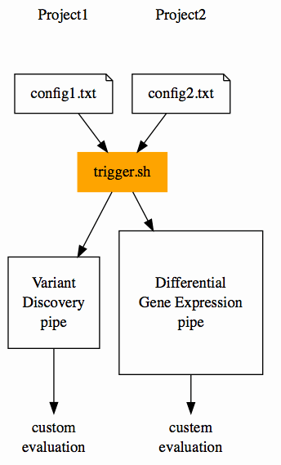
Aim: Reduce Set-up-overhead
Reduce the overhead for setting up a project
Benefit from other people’s efforts
However, different projects require different tools, so flexibility needs to be provided.
automatic

Slide 8
Bundle Tasks in Modules: <task>.sh
Input
(e.g. line.fastq)
Modular conceptual blocks
Plug & Play
Contribution from users
bwa aln
bwa sampe
samtools index
dedup
…
Raw
reads
Variants
Raw
reads
TFBS sites
Output
(e.g. line.bam)
Raw
reads
Transcripts

Slide 9
The Trigger
trigger.sh is the one access point to NGSANE
Private Data
Shared Code
Scripts
trigger.sh
<tasks>.sh
Project
configs (task)
Raw data
Results
Software

Slide 10
Project setup
Create a project folder and a fastq folder therein
Create (as many) context folders as needed within the fastq directory and put your raw data there
Copy sample config files for required tasks and adjust settings
Fastq
Sub1
Sub2
Project
config
s_1_read1.fastq
s_1_read2.fastq
s_2_read1.fastq
s_2_read2.fastq
s_3_read1.fastq
s_3_read2.fastq
s_4_read1.fastq
s_4_read2.fastq

Slide 11
The Trigger - 3 simple steps (+coffee)
Setup project on HPC
Load module (gives you access to the trigger)
module load gi/ngsane/<version>
Check what you want to do
trigger.sh config.txt
Get things done (submit jobs)
trigger.sh config.txt armed
trigger.sh
config.txt
config.txt
trigger.sh
config.txt
armed
Spawn len(*.fastq) parallel jobs
... treat yourself to a coffee and do other stuff while the jobs are running

Slide 12
Folder-structure after job finish
Fastq
Sub1
Sub2
qout
bwa
reCaAl
Variants
Sub2
Sub1
Bwa
reCaAl
Bwa
reCal
Project
Summary
s_1_read1.fastq
s_1_read2.fastq
s_2_read1.fastq
s_2_read2.fastq
s_3_read1.fastq
s_3_read2.fastq
s_4_read1.fastq
s_4_read2.fastq
Sub1_s_1.out
Sub1_s_2.out
Sub2_s_3.out
Sub2_s_4.out
Sub1_s_1.out
Sub1_s_2.out
Sub2_s_3.out
Sub2_s_4.out
s_1.bam
s_2.bam
s_1.ashrr.bam
s_2.ashrr.bam
s_3.bam
s_4.bam
s_3.ashrr.bam
s_4.ashrr.bam
A unified folder structure allows other researcher/lab
members (familiar with it) to understand what to did.

Slide 13
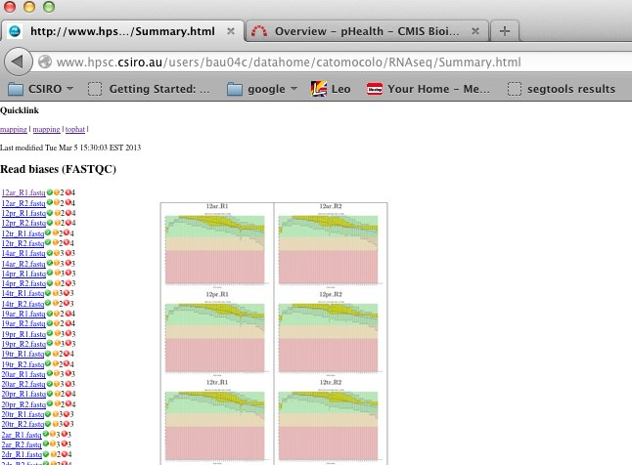
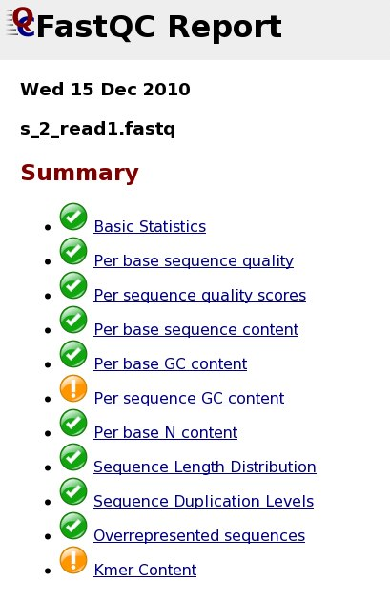
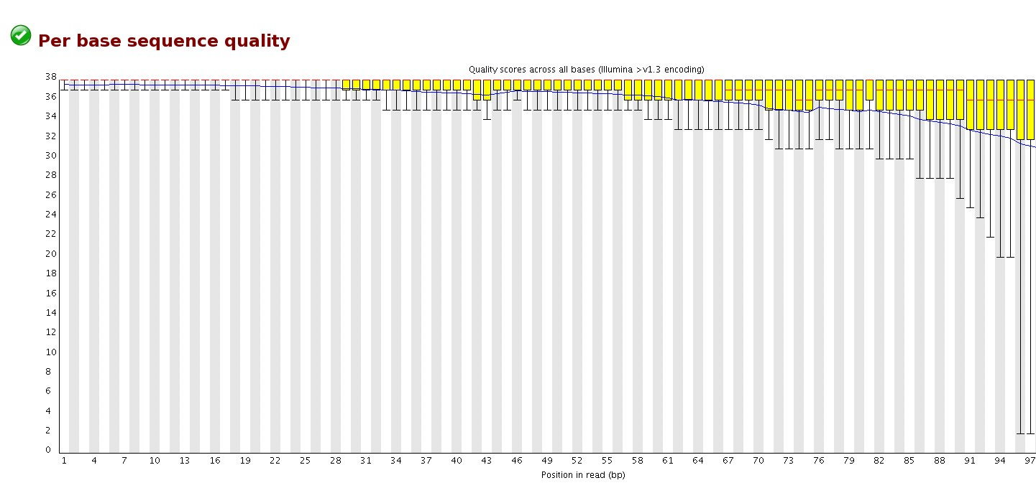
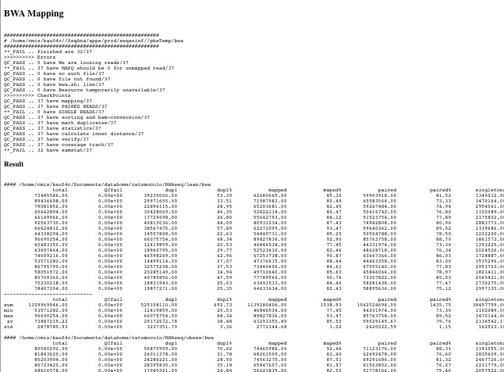
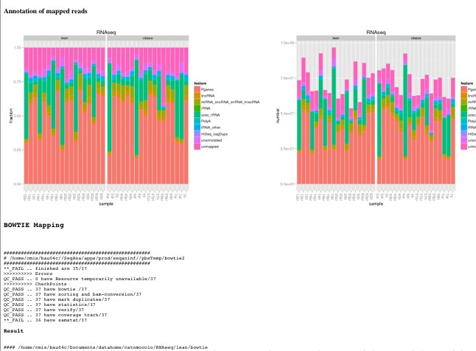
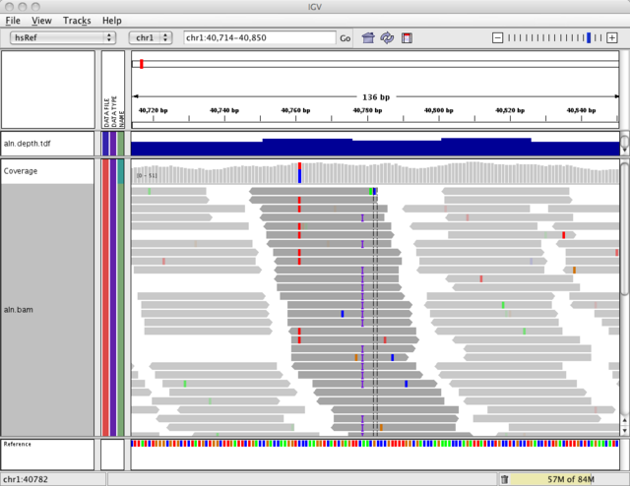

There is more
Validate and summarize outcome
trigger.sh config.txt html
trigger.sh
config.txt
html
Run check
points
Sequence statistics
Mapping stats
Summary plots
Data Visualization
Download

Slide 14
NGSANE does
provide production informatics for NGS experiments (defined as data processing required to convert raw fastq data into aligned reads or calls on differential gene expression etc pp)
enhance productivity by reducing overhead of set-up and scripting for new projects
enable efficient use of cluster resources by separating the data from the programs operating on them
promote experimental reproducibility by documenting workflow and programs (version) used to process the raw data
provide a unified framework (e.g. common folder structure ) for processing of raw data obtained from different experimental protocols. This helps lab members familiar with the framework to understand their colleagues work, which can be crucial when somebody is not available or has move on to new challenges outside Garvan.
provides distributed data processing thus allowing us to do the interesting analysis earlier (HPC cluster is required)
generates a high level summary html file to enable informed decisions about the experimental success
provide an access point for new lab bioinformatics members/collaborators

Slide 15
NGSANE does NOT
does not expose any kind of data (raw or processed) to other labs or the public
does not slow down software incorporation (needing GUI parameter definitions, customized wrappers, language-specific overhead)
does not automatically analyze data with respect to a specific research question
does not take the responsibility from you of you knowing what you are doing and what the results mean

Slide 16
NGSANE is Meant to
Be by bioinformaticians for bioinformaticians
Be a community effort
chip in if you are an expert on a topic
no pressure though - take what you need
Iterative / Sequencial (run a task at a time and check quality measures)
Be easily repeatable (tasks can be re-submitted for individual files)
Flexible
Anything can be overwritten easily
new software can be incorporated easily (i.e. directly from the bash development script)

Slide 17
NGSANE Currently supports
Transfer data (smbclient)
Quality Control
(GATK, FastQC, RNA-SeQC, custom summaries, user code)
Trimming
(Cutadapt,Trimgalore, Trimmomatic)
Mapping
(BWA,Bowtie1,Bowtie2,Tophat)
Transcript Quantification
(cufflinks, htseq, bedtools)
Variant calling
(GATK, samtools)
Variant annotation
(annovar)
3D Genome structure
(Hicup, fit-hi-c, Hiclib, Homer)

Slide 18
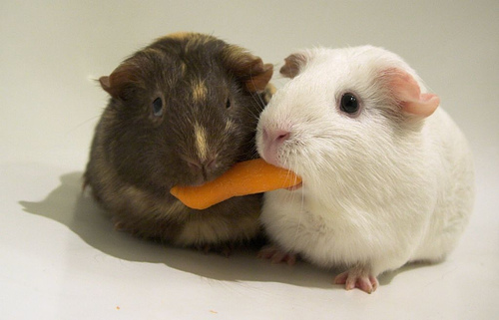

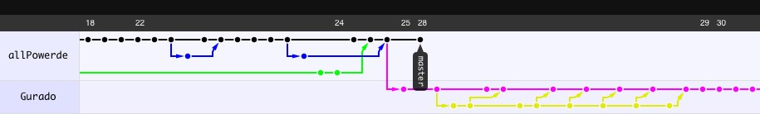
How to get it
Fork from github
https://github.com/allPowerde/ngsane
denis.bauer@csiro.au
[Photo Credit: ryancr]
CSIRO
Garvan

Slide 19
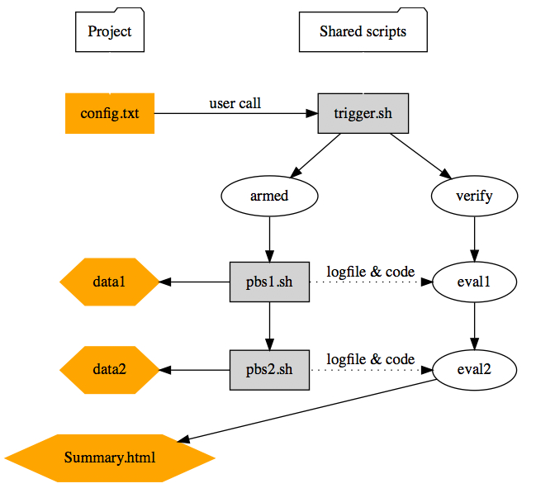
NGSANE details
Keeping data separate from scripts
Automating verification, quality control and summary HTML generation
Rerunning pipeline from every point

Slide 20
Project-specific parameters: Config.txt
#********************
# Tasks
#********************
RUNMAPPINGBWA="1"
RUNREALRECAL="1"
#********************
# Paths
#********************
FASTA="$DATASTORE/resources/hg19/hg19.fasta"
DBSNP="$DATASTORE/resources/hg19/snpdb132.vcf"
#********************
# PARAMETER
#********************
LIBRARY=”RNAseqObeseVsLean”
ADDPARAMBWA=“--force single”
Specifics what to do,
e.g. mapping and recalibration
Specifics where to find resources
Customizes standard scripts for this project

Slide 21
Flexible generic defaults: header.sh
#********************
# Programs
#********************
MODULE_BWA=“bwa/2.0.1 R/2.15.1 samtools/0.1.18"
PATH_BWA=“/apps/bwa/:/apps/samtools/"
#********************
# Names & Types
#********************
TASKBWA="bwa"
READONE="R1"
FASTQ="fastq.gz"
#********************
# Resources
#********************
WALLTIME_BOWTIE=10:00:00
MEMORY_BOWTIE=60
NODES_BOWTIE="nodes=1:ppn=8"
Program paths or modules to use
Default names and endings
Typical resource usage for each tool

Slide 22
Scaffold of pbsScripts.sh: Error catching
Code example for setting up what errors to look out for
# QCVARIABLES, loosing reads, unmapped read,no such file,file not found,bwa.sh: line
Output in Summary.html
>>>>>>>>>> Errors
QC_PASS .. 0 have We are loosing reads/184
QC_PASS .. 0 have for unmapped read/184
QC_PASS .. 0 have no such file/184
QC_PASS .. 0 have file not found/184
QC_PASS .. 0 have bwa.sh: line/184

Slide 23
Scaffold of pbsScripts.sh: checkpoints
qsub -b y -j y [PBSOPTIONS] pbsScript.sh -k HISEQINF [PARAMETERS]
Code example for setting up checkpoints in the pbsScript.sh
echo “********* mapping”
$BWA aln -t $THREADS $FASTA $f > $OUT/${n/$FASTQ/sai}
$BWA aln -t $THREADS $FASTA ${f/$READONE/$READTWO} > $OUT/${n/$READONE.$FASTQ/$READTWO.sai}
Output in Summary.html
>>>>>>>>>> CheckPoints
QC_PASS .. 184 have mapping/184
QC_PASS .. 184 have sorting and bam-conversion/184
QC_PASS .. 184 have mark duplicates/184
QC_PASS .. 184 have statistics/184
QC_PASS .. 184 have coverage track/184

Slide 24
Scaffold of pbsScripts.sh: checkpoints
qsub -b y -j y [PBSOPTIONS] pbsScript.sh -k HISEQINF [PARAMETERS]
Code example for setting up checkpoints in the pbsScript.sh
echo ">>>>> readmapping with Tophat "
echo ">>>>> startdate "`date`
echo ">>>>> hostname "`hostname`
echo ">>>>> job_name "$JOB_NAME
echo ">>>>> job_id "$JOB_ID
echo ">>>>> tophatcuff.sh $*"
Output in qout.out
>>>>> readmapping with Tophat
>>>>> startdate Tue Nov 15 16:32:45 EST 2011
>>>>> hostname compute-0-16.local
>>>>> job_name tophat2_BigKCL50_s_1_1
>>>>> job_id 240922
>>>>> tophatcuff.sh -k config.txt -r /clusterdata/hiseq_apps/resources/freeze001/mm9/mm9.fasta -f /illumina/Data/110823_SN417_0129_BB00M8ABXX//fastq/BigKCL50/s_1_1_read1.fastq -t 24 -o /illumina/Data/ …

Slide 25
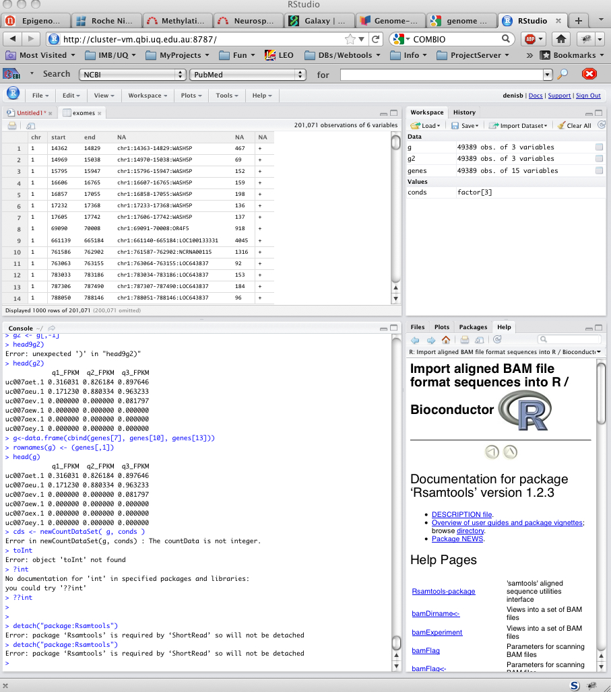
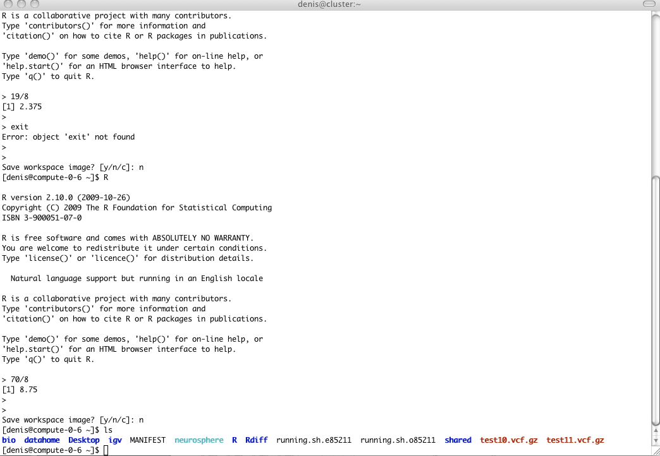
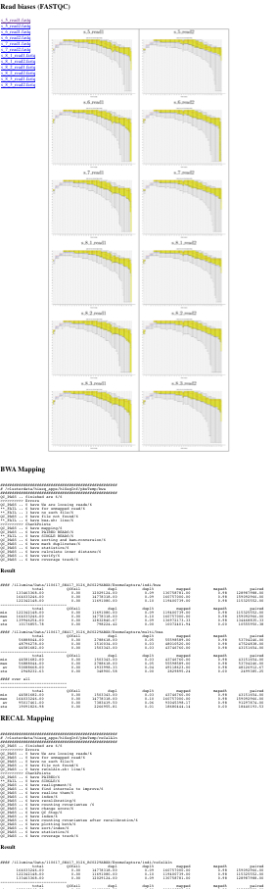
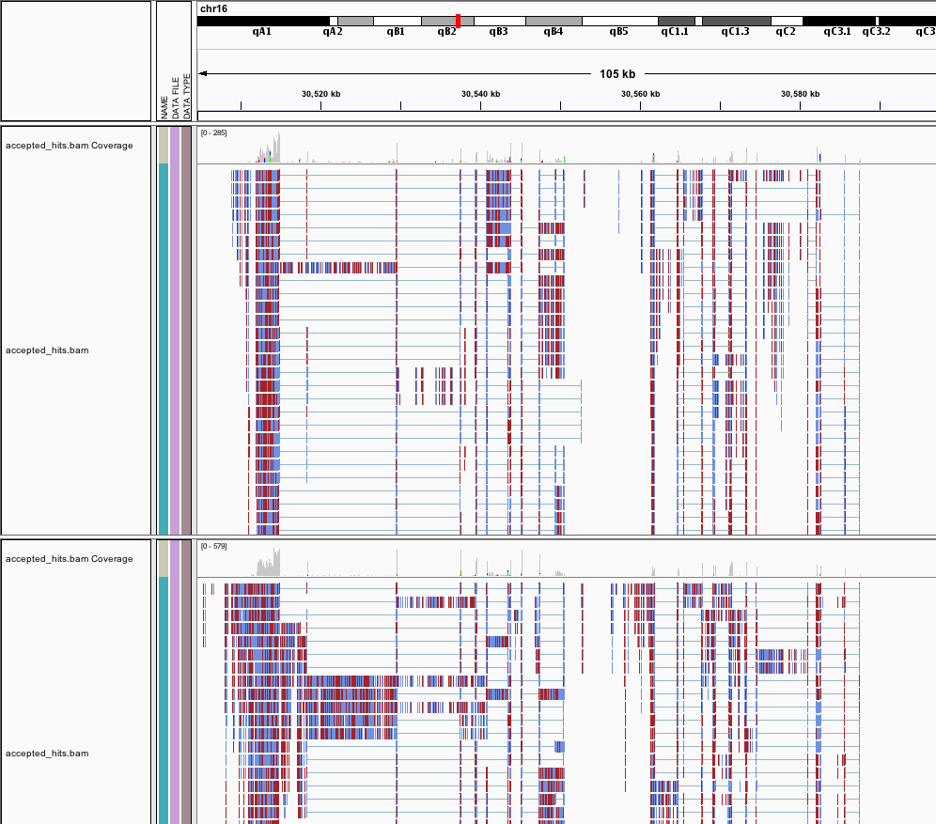
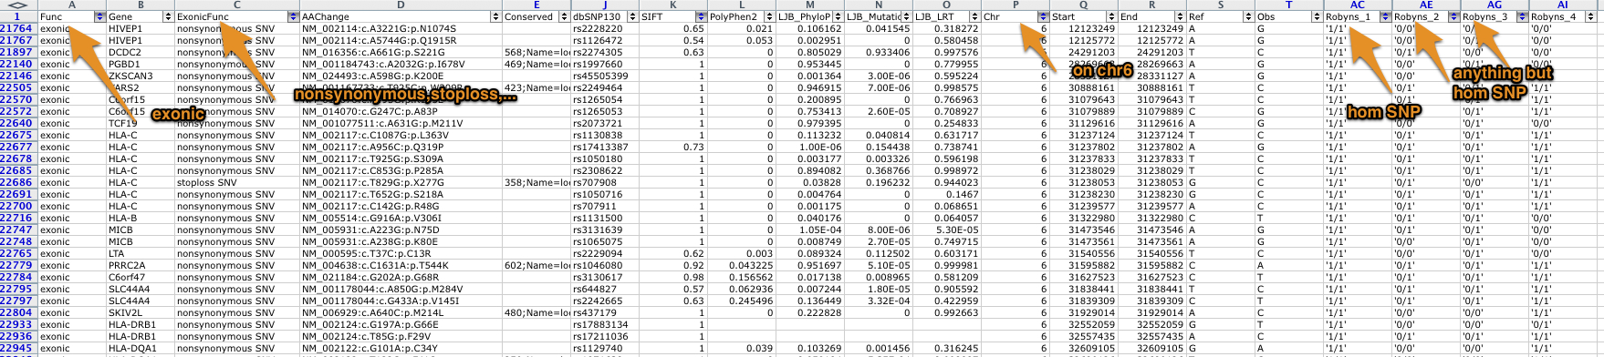
Download-free availability:
1
Website
2
Command line
3
Rstudio
4
Genome Viewer
5
Excel-like

Slide 26
Supported pipelines
# General
fastQC -- run fastQC
RUNTRIMMING -- trim to a certain read length $TRIMLENGTH
RUNDOWNSAMPLING -- downsample to a certain number of reads $READNUMBER
DOWNSAMPLE -- downsample to a certain coverage
DEPTHOFCOVERAGE -- depth of coverage calculation can take a certain $REF
# Variant calling
RUNMAPPINGBWA -- run bwa (paired and single ended)
RUNREALRECAL -- realign and recalibrate quality score of mapped reads
RUNVARCALLS -- variant calling either combined or separate ($VARPERFOLDER) of all samples
RUNANNOTATION -- run Annovar annotation
# mRNA seq
RUNTOPHATCUFF -- run tophat and cufflinks
RUNCUFFDIFF -- differential expression detection (not really automated)
#methylation
RUNMAPPINGRRBS -- run reduced representation mapping of bisulfid reads

Slide 27
Cluster organization
Reference resources
Hg18,hg19,b37
dbSNPv132
HapMap
Programs
Freeze/ Bwa, tophat, MACs, GATK, … (~25 programs)
Devel/ <- you can install programs into that other people can use
HiSeqInf
Trigger.sh
Program.sh scripts (~37 scripts)

Slide 28
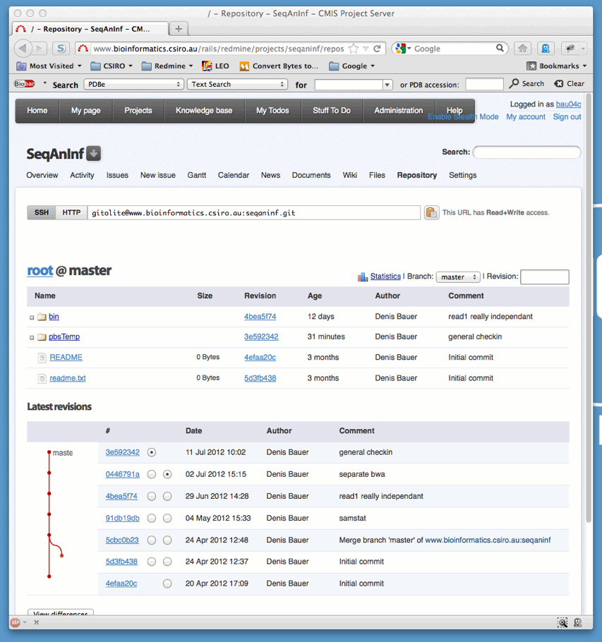
Version control of pbsscripts
Git repository on project server
[Photo Credit: ryancr]

Slide 29
Project Server
[Photo Credit: ryancr]
The way to plan and share research

Slide 30

Bad Practice
Back-up and share individual important files on group-share
Forget to upload latest version?
Need to recall how data was generated ?
Need a previous version ?
Broken or deleted a file ?
Find files ?
Sort out paths/programs ?
[Photo Credit: myconfinedspace]
Notes:
http://www.myconfinedspace.com/wp-content/uploads/2007/06/sinister-cat-line-up.jpg

Slide 31
Version Control via Git
Repository:
Redmine
Local Versions:
Neil
Rob
Mike

Slide 32
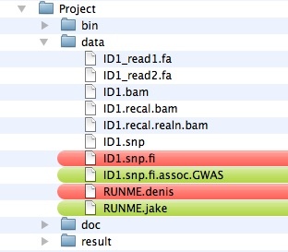
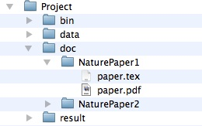
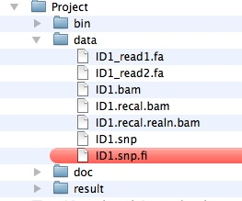
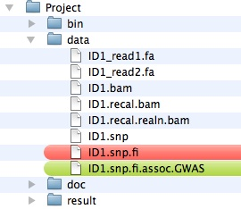
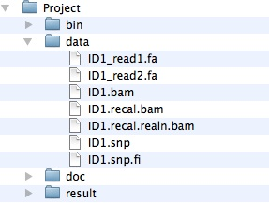
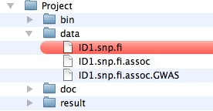
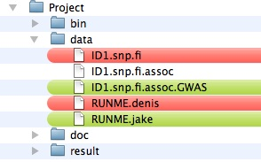
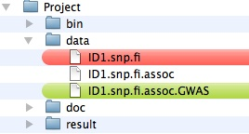
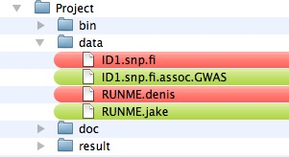
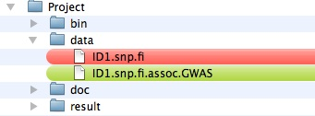
How to version control result files
Folder structure (denis)
Folder structure (bruce)
Folder structure (repository)

Slide 33


Research Workflow
Workflow
Identify long term goal (e.g. paper)
Identify task to achieve the goal in Meetings
Assign person to handle tasks
Record progress in the task
Add final result file to the version control to share
Write wiki/news article to summarize outcome
Benefits
back-up automatic,
Share scripts in the folder structure they were created for,
Share outcome files,
Annotate files in our project server
Searchable knowledge space

Slide 34
The big picture
Covering all aspects of: design*, set-up*, maintenance*, usage
(*except cluster)
Documentation: Project Server
//project
7 project-cards
10 Projects, 6 HiSeq-Runs
40 wiki pages, 250 Tasks, 551h logged
5 TB raw data
750 GB processed data
57 GB external data
160 Commits
35 external programs
41 custom scripts (4197 lines of code)
Application
Data Warehousing
Backup/Version Control
Statistic
Analysis
RSudio
Raw Data
HiSeq Output
Quality Control
Project Cards
Processed Data
Processed Data
Rsync
Hypothesis Generation
Visualization
Software
BWA, GATK, samtools, etc.
IGV
Genome Browser
Custom Scripts
Version Control
Custom Scripts
Data
Processing and Analysis
Cluster
External Genomic Resources
Genomes, Annotation, etc.
Project Server
Content
Galaxy
//cluster-vm
//clusterstorage
//groupshare, //ethan

Slide 35
Private Data
Shared Code
Scripts
trigger.sh
<tasks>.sh
Project
configs (task)
NGSANE
Raw data
Results
Software
CMIS
CMIS
Denis C. Bauer Research Scientist
t +61 2 9325 3174
E Denis.Bauer@csiro.au
w www.csiro.au/cmis

